Slide 1
Transcription

Slide 16
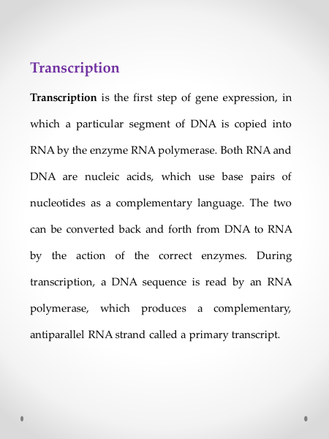

Slide 17
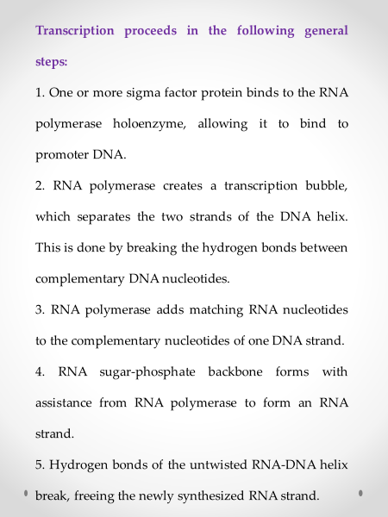

Slide 18
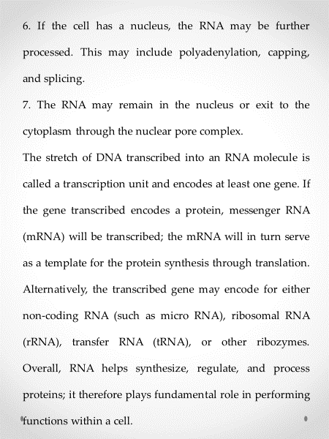

Slide 20
Regulation of transcription
A gene consists of a transcriptional region and a regulatory region. The transcriptional region is the part of DNA to be transcribed into a primary transcript (an RNA molecule complementary to the transcriptional region). The regulatory region can be divided into cis-regulatory (or cis-acting) elements and trans-regulatory (or trans-acting) elements. The cis-regulatory elements are the binding sites of transcription factors which are the proteins that, upon binding with cis-regulatory elements, can affect (either enhance or repress) transcription. The trans-regulatory elements are the DNA sequences that encode transcription factors.

Slide 21
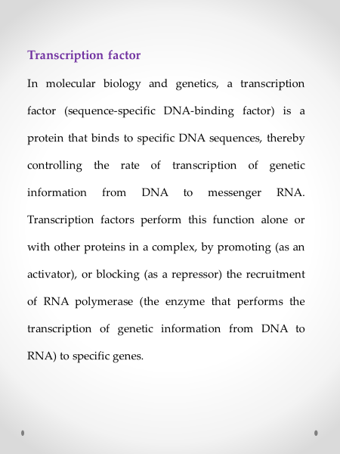

Slide 22
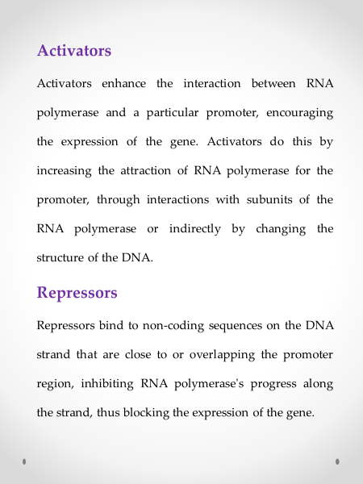

Slide 23
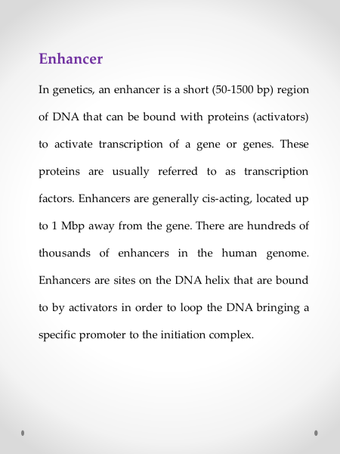

Slide 24
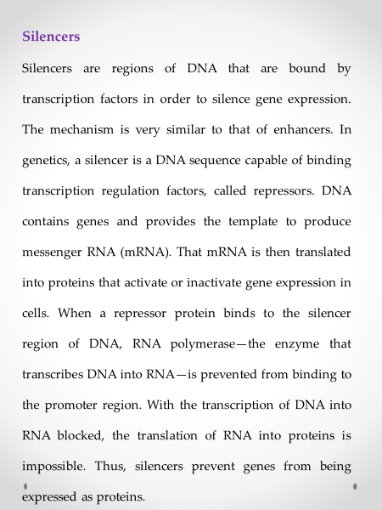

Slide 25
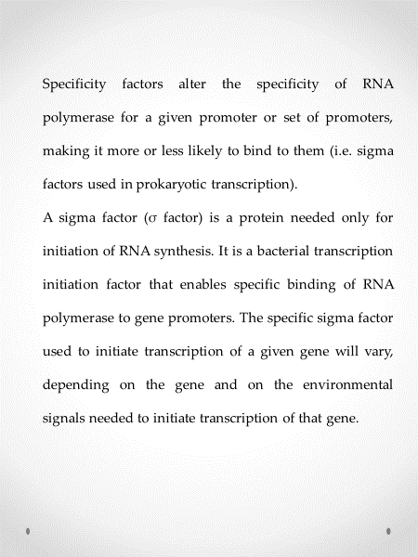

Slide 26
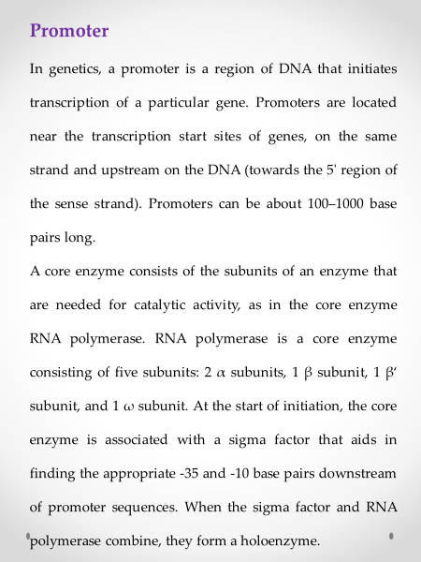

Slide 27
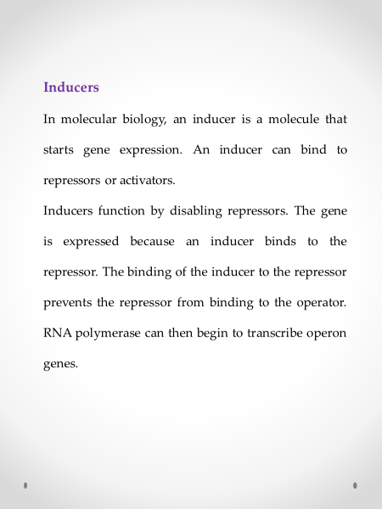

Slide 28
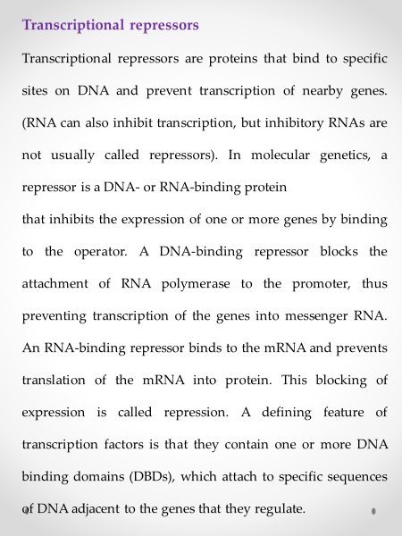

Slide 29
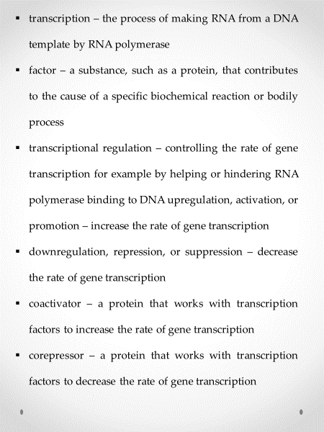

Slide 30
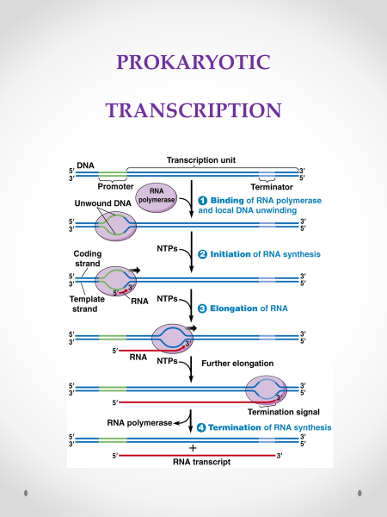

Slide 31
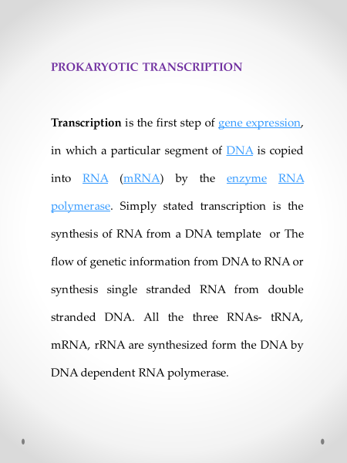

Slide 32
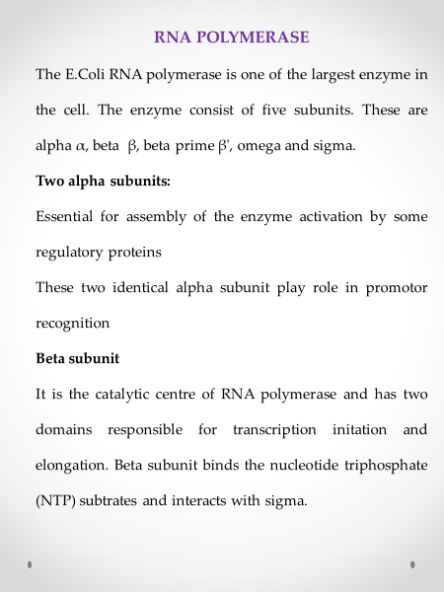

Slide 33
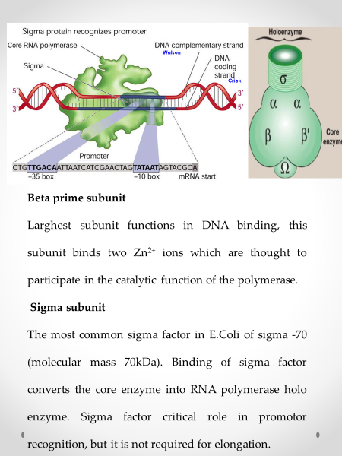

Slide 34
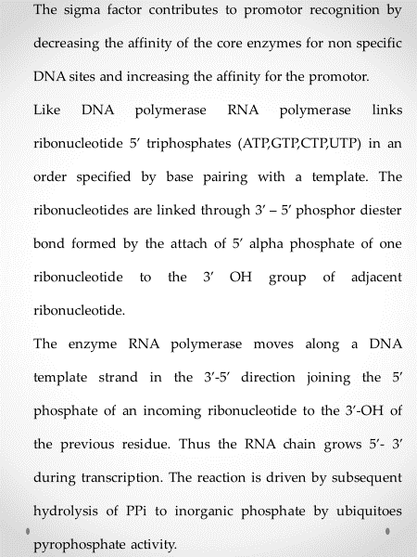

Slide 35
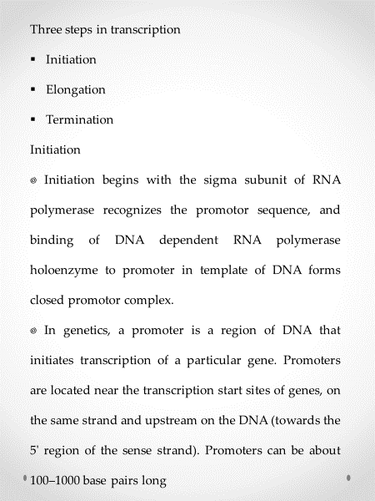

Slide 36
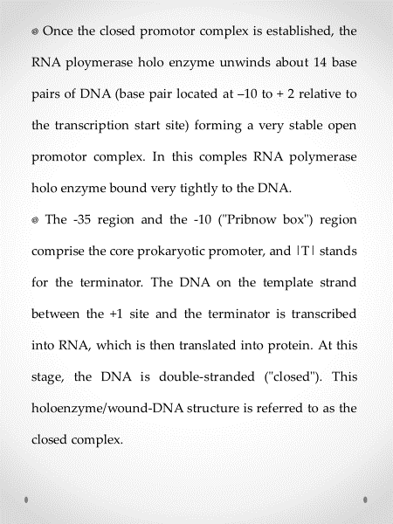

Slide 37
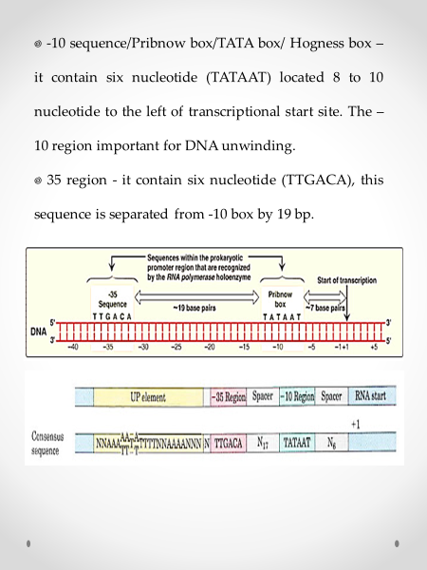

Slide 38
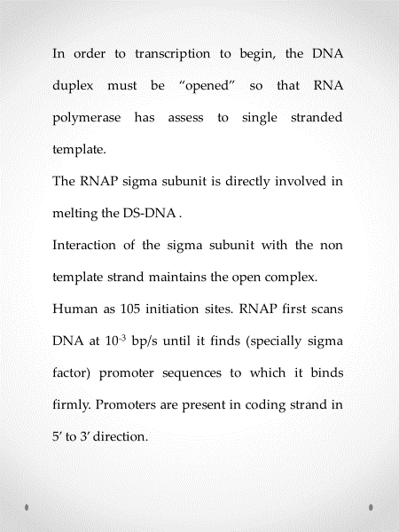

Slide 39
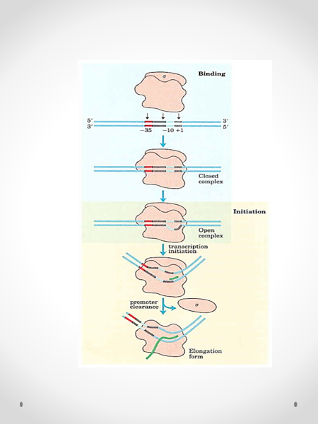

Slide 40
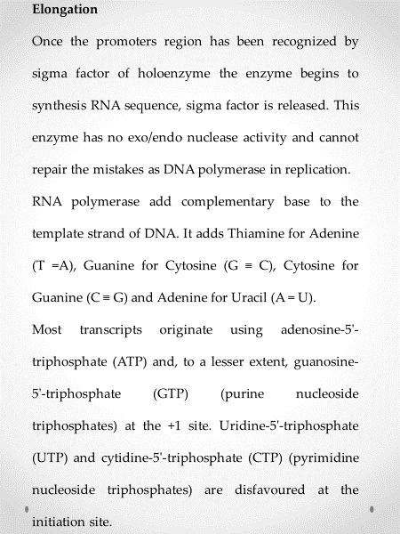

Slide 41
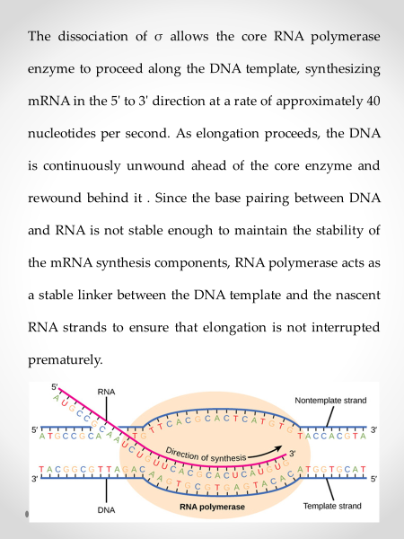

Slide 42
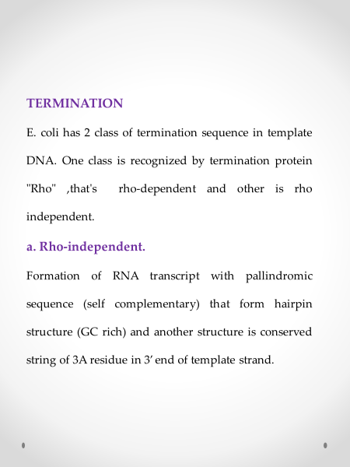

Slide 43
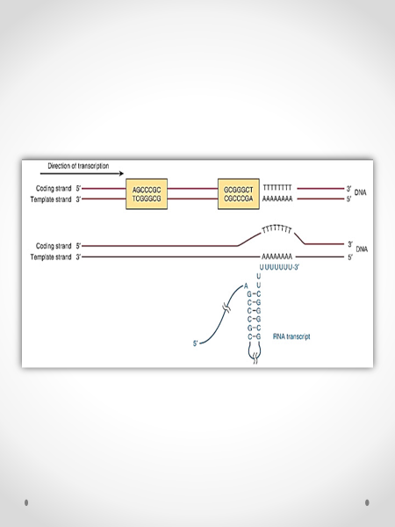

Slide 44
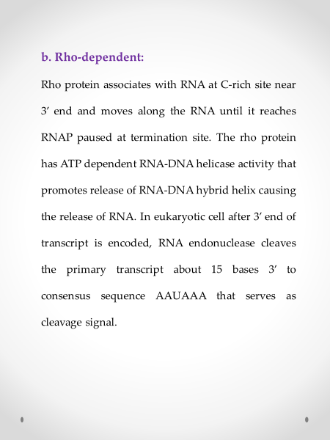

Slide 45
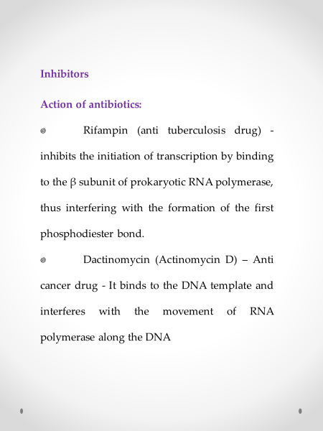

Slide 46
EUKARYOTIC TRANSCRIPTION

Slide 47
EUKARYOTIC TRANSCRIPTION
Eukaryotic transcription is the elaborate process that eukaryotic cells use to copy genetic information stored in DNA into units of RNA replica. A eukaryotic cell has a nucleus that separates the processes of transcription and translation. Eukaryotic transcription occurs within the nucleus, where DNA is packaged into nucleosomes and higher order chromatin structures. The complexity of the eukaryotic genome requires a great variety and complexity of gene expression control.
Eukaryotic transcription proceeds in three sequential stages: initiation, elongation, and termination. The transcriptional machinery that catalyzes this complex reaction has at its core three multi-subunit RNA polymerases.

Slide 48
Eukaryotes have three nuclear RNA polymerases, each with distinct roles and properties

Slide 49
RNA polymerase I
▪RNA polymerase I (Pol I) catalyzes the transcription of all rRNA genes except 5S rRNA.
▪These rRNA genes are organized into a single transcriptional unit and are transcribed into a continuous transcript.
▪This precursor is then processed into three rRNAs: 18S, 5.8S, and 28S. The transcription of rRNA genes takes place in a specialized structure of the nucleus called the nucleolus, where the transcribed rRNAs are combined with proteins to form ribosomes.

Slide 50
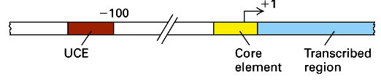
Promoter Structure: For RNA pol-I:
▪ Genes for ribosomal RNA are exclusively transcribed by RNA polymerase-I.
▪ In eukaryotic system most active and highly productive genes, which are transcribed most of the time, are ribosomal RNA genes.
▪ More than 90 % of the total RNA found in any eukaryotic cell is rRNA.
▪ Its synthesis is triggered, when cells are activated for cell proliferation, in such situations tremendous increase of rRNA takes place, ex. rRNA synthesis during oogenesis is an excellent example.

Slide 51
Initiation
▪ It has, what is termed as core promoter region between (-) 10 and (-) 45 and an upstream control elements (UCE), it is the region to which upstream element binding factors bind.
▪ The core region attracts selectivity factor SL-I, 3 TAFs (TBP associated factors) and TBP (TATA binding factors). Positioning of the TBP is assisted and determined by the SL-I and then TAFs bring TBP.
▪ It is now known that two histone like proteins are also associated with this complex.
▪ This assembly ultimately brings RNA pol-I to the site. But the activation depends on upstream control element binding factors UBF 1; they bind not only to the core but also to UCE.
▪ UBFI binding results in protein-protein interaction in such a way two units of UBFs join with one another with a DNA loop, and activate the RNA pol-I complex.

Slide 52
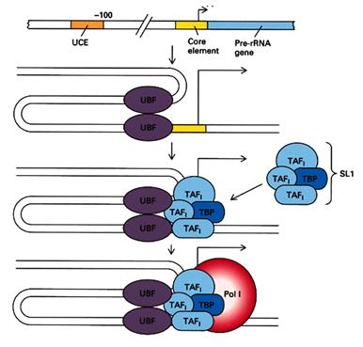

Slide 53
Elongation
As Pol I escapes and clears the promoter, UBF and SL1 remain-promoter bound, ready to recruit another Pol I. Indeed, each active rDNA gene can be transcribed multiple times simultaneously. Pol I does seem to transcribe through nucleosomes, either bypassing or disrupting them, perhaps assisted by chromatin-remodeling activities. In addition, UBF might also act as positive feedback, enhancing Pol I elongation through an anti-repressor function. An additional factor, TIF-IC, can also stimulate the overall rate of transcription and suppress pausing of Pol I. As Pol I proceeds along the rDNA, supercoils form both ahead and behind the complex. These are unwound by topoisomerase I or II at regular interval, similar to what is seen in Pol II-mediated transcription. Elongation is likely to be interrupted at sites of DNA damage. Transcription-coupled repair occurs similarly to Pol II-transcribed genes and require the presence of several DNA repair proteins, such as TFIIH, CSB, and XPG.

Slide 54
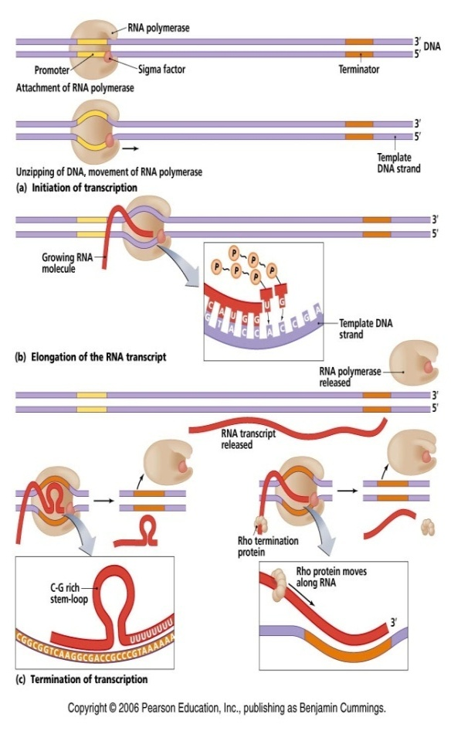

Slide 55
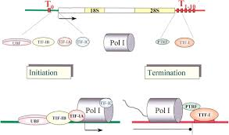
Termination
In higher eukaryotes, TTF-I binds and bends the termination site at the 3' end of the transcribed region. This will force Pol I to pause. TTF-I, with the help of transcript-release factor PTRF and a T-rich region, will induce Pol I into terminating transcription and dissociating from the DNA and the new transcript. Evidence suggests that termination might be rate-limiting in cases of high rRNA production. TTF-I and PTRF will then indirectly stimulate the reinitiation of transcription by Pol I at the same rDNA gene. In organisms such as budding yeast the process seems to be much more complicated.

Slide 56
rRNA Synthesis and Processing
The genes coding for rRNA (except 5S rRNA) are located in the nucleolar part of the nucleus. The rRNA genes are highly repetitious and mammalian cells contain 100 to 2000 copies of the rRNA genes per cell. The genes are organised in transcription units separated by non-transcribed spacers. Each transcription unit contains sequences coding for 18S, 5.8S and 28S rRNA.
The transcription units are transcribed by RNA polymerase I into giant RNA molecules, primary transcripts, that in addition to the sequences corresponding to 18S, 5.8S and 28S rRNA contains external and internal transcribed spacer sequences. The rate of nucleolar transcription is very high and many polymerases operate on the same transcription unit. The transcriptionally active DNA therefore has a Christmas tree-like appearance on electron microscopic pictures.

Slide 57
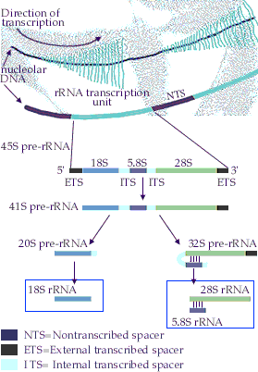

Slide 58
The primary transcript is processed into the mature 18S, 5.8S and 28S rRNAs. The processing involves exo- and endo-nucleolytic cleavages guided by snoRNA (small nucleolar RNAs) in complex with proteins. The mature rRNAs contain modified nucleotides which are added after transcription by a snoRNA-dependent mechanism.
5S ribosomal RNA is transcribed by RNA polymerase III in the nucleoplasm. Each eukaryotic cell contains a high number of copies of the 5S coding gene (up to 20 000 copies per cell). 5S rRNA contains overlapping binding sites for two different proteins, ribosomal protein L5 and transcription factor TFIIIA. The mutual exclusive binding of these two proteins to 5S rRNA is important for coordinating the expression of 5S rRNA to the production of the other rRNAs.

Slide 59
RNA polymerase II
RNA polymerase II
▪ RNA polymerase II (RNAP II and Pol II) is an enzyme found in eukaryotic cells. It catalyzes the transcription of DNA to synthesize precursors of mRNA and most snRNAs, siRNAs, and all miRNAs. A 550 kDa complex of 12 subunits, RNAP II is the most studied type of RNA polymerase. A wide range of transcription factors are required for it to bind to upstream gene promoters and begin transcription.
▪ Many Pol II transcripts exist transiently as single strand precursor RNAs (pre-RNAs) that are further processed to generate mature RNAs. For example, precursor mRNAs (pre-mRNAs) are extensively processed before exiting into the cytoplasm through the nuclear pore for protein translation.

Slide 60
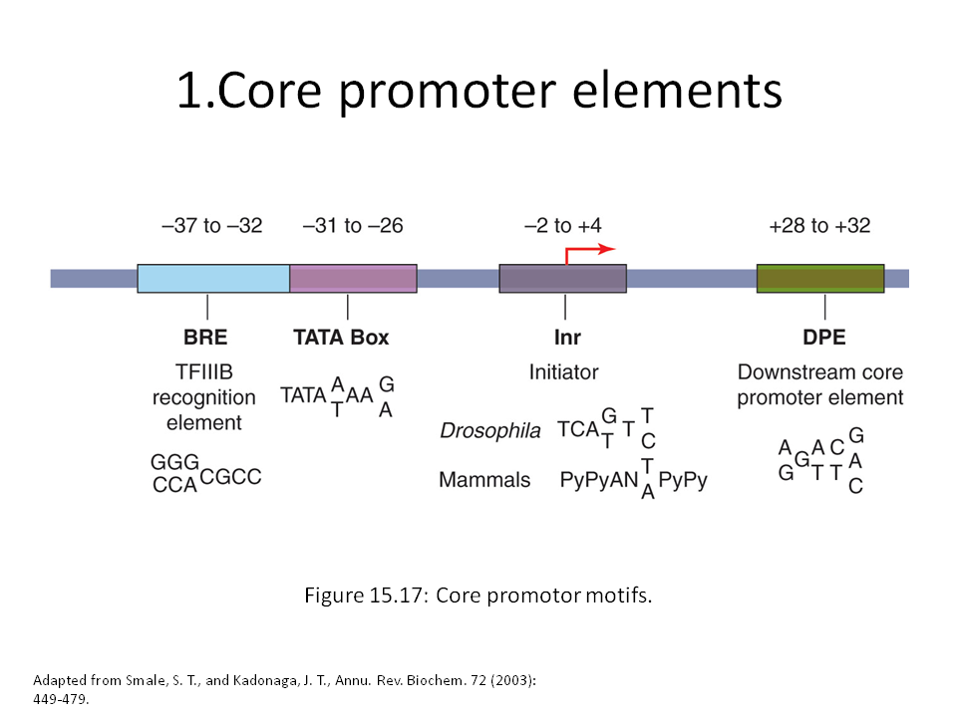
Promoter RNA polymerase – II
Most eukaryotes use TATA box (it's a little further away from initiation start area). In eukaryotes, the promoters are a little more complex, these elements functionally analogous to the -10 and -35 in prokaryotes, they orient polymerase and bind proteins.

Slide 61
Initiation
To begin transcription, eukaryotic RNA polymerase II requires the general transcription factors. These transcription factors are called TFIIA, TFIIB, and so on. (A) The promoter contains a DNA sequence called the TATA box, which is located 25 nucleotides away from the site where transcription is initiated. (B) The TATA box is recognized and bound by transcription factor TFIID, which then enables the adjacent binding of TFIIB. (C) For simplicity the DNA distortion produced by the binding of TFIID is not shown. (D) The rest of the general transcription factors as well as the RNA polymerase itself assemble at the promoter. (E) TFIIH uses ATP to pry apart the double helix at the transcription start point, allowing transcription to begin. TFIIH also phosphorylates RNA polymerase II, releasing it from the general factors so it can begin the elongation phase of transcription. As shown, the site of phosphorylation is a long polypeptide tail that extends from the polymerase molecule.

Slide 62
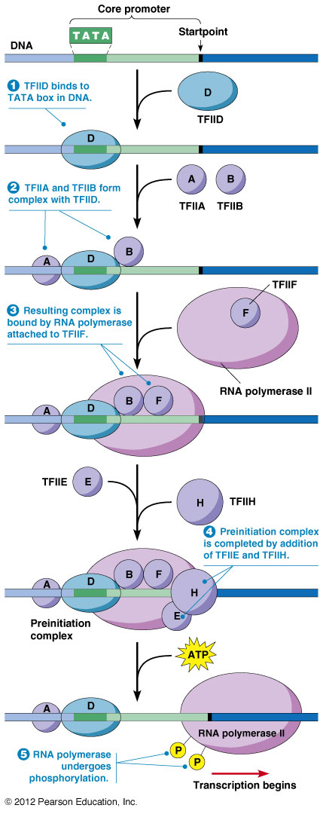

Slide 63
Processing of mRNA
All the primary transcripts produced in the nucleus must undergo processing steps to produce functional RNA molecules for export to the cytosol. We shall confine ourselves to a view of the steps as they occur in the processing of pre-mRNA to mRNA.
The steps:
• Synthesis of the cap. This is a stretch of three modified nucleotides attached to the 5' end of the pre-mRNA.
• Synthesis of the poly (A) tail. This is a stretch of adenine nucleotides attached to the 3' end of the pre-mRNA.
• Step-by-step removal of introns present in the pre-mRNA and splicing of the remaining exons. This step is required because most eukaryotic genes are split.

Slide 64
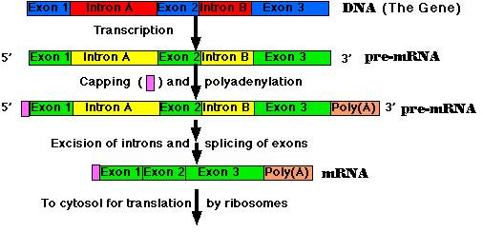

Slide 65
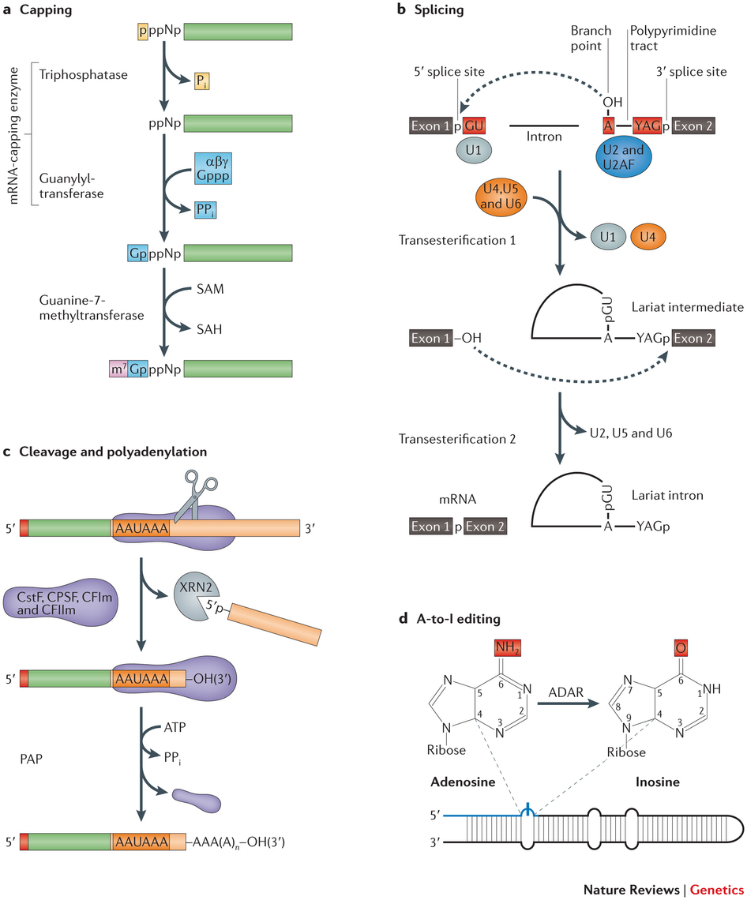

Slide 66
5' cap addition
• A 5' cap (also termed an RNA cap, an RNA 7-methylguanosine cap, or an RNA m7G cap) is a modified guanine nucleotide that has been added to the "front" or 5' end of a eukaryotic messenger RNA shortly after the start of transcription. The 5' cap consists of a terminal 6-methylguanosine residue that is linked through a 5'-5'-triphosphate bond to the first transcribed nucleotide. Its presence is critical for recognition by the ribosome and protection from RNases.
• Shortly after the start of transcription, the 5' end of the mRNA being synthesized is bound by a cap-synthesizing complex associated with RNA polymerase. This enzymatic complex catalyzes the chemical reactions that are required for mRNA capping. Synthesis proceeds as a multi-step biochemical reaction.

Slide 67
Splicing
Splicing is the process by which pre-mRNA is modified to remove certain stretches of non-coding sequences called introns; the stretches that remain include protein-coding sequences and are called exons. Sometimes pre-mRNA messages may be spliced in several different ways, allowing a single gene to encode multiple proteins. This process is called alternative splicing. Splicing is usually performed by an RNA-protein complex called the spliceosome, but some RNA molecules are also capable of catalyzing their own splicing.

Slide 68
Editing
Polyadenylation
Polyadenylation is the covalent linkage of a polyadenylyl moiety to a messenger RNA molecule. In eukaryotic organisms, with the exception of histones, all messenger RNA (mRNA) molecules are polyadenylated at the 3' end. The poly (A) tail and the protein bound to it aid in protecting mRNA from degradation by exonucleases. Polyadenylation is also important for transcription termination, export of the mRNA from the nucleus, and translation. mRNA can also be polyadenylated in prokaryotic organisms, where poly(A) tails act to facilitate, rather than impede, exonucleolytic degradation.

Slide 69
Polyadenylation occurs during and immediately after transcription of DNA into RNA. After transcription has been terminated, the mRNA chain is cleaved through the action of an endonuclease complex associated with RNA polymerase. After the mRNA has been cleaved, around 250 adenosine residues are added to the free 3' end at the cleavage site. This reaction is catalyzed by polyadenylate polymerase. Just as in alternative splicing, there can be more than one polyadenylation variant of an mRNA.
Polyadenylation site mutations also occur. The primary RNA transcript of a gene is cleaved at the poly-A addition site, and 100-200 A’s are added to the 3’ end of the RNA. If this site is altered, an abnormally long and unstable mRNA results. Several beta globin mutations alter this site: one example is AATAAA -> AACAAA. Moderate anemia was result.

Slide 70
RNA polymerase III
RNA polymerase III
RNA polymerase III (Pol III) transcribes small non-coding RNAs, including tRNAs, 5S rRNA, U6 snRNA, SRP RNA, and other stable short RNAs such as ribonuclease P RNA.
Structure of eukaryotic RNA polymerase
▪ RNA Polymerases I, II, and III contain 14, 12, and 17 subunits, respectively.
▪ All three eukaryotic polymerases have five core subunits that exhibit homology with the β, β’, αI, αII, and ω subunits of E. coli RNA polymerase.
▪ An identical ω-like subunit (RBP6) is used by all three eukaryotic polymerases, while the same α-like subunits are used by Pol I and III.

Slide 71
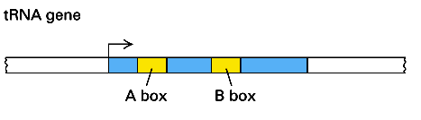
The three eukaryotic polymerases share four other common subunits among themselves. The remaining subunits are unique to each RNA polymerase. The additional subunits found in Pol I and Pol III relative to Pol II, are homologous to Pol II transcription factors.
▪ Crystal structures of RNA polymerases I and II provide an opportunity to understand the interactions among the subunits and the molecular mechanism of eukaryotic transcription in atomic detail.

Slide 72
Promoter for RNA polymerase – III
▪ RNA pol-III transcribes small molecular weight RNAs such as tRNAs, 5sRNAs, 7sKRNAs, 7sLRNAs, U6sn RNAs, some ncRNAs and it also transcribes some ADV, EBV and many eukaryotic viral genes.
▪ The 5s rRNA and tRNA genes have promoters within the coding region of the gene.
▪ The promoter regions for 7S and U6sn RNAs, more or less, look like RNA pol-II promoters, with little differences.
▪ Though the size of the genes is small ranging from 160 to 400 bp, their promoters are well defined for transcriptional initiation from their respective Start sites in the promoters.

Slide 73
Initiation
Initiation: the construction of the polymerase complex on the promoter. Pol III is unusual (compared to Pol II) requiring no control sequences upstream of the gene, instead normally relying on internal control sequences - sequences within the transcribed section of the gene (although upstream sequences are occasionally seen, e.g. U6 snRNA gene has an upstream TATA box as seen in Pol II Promoters).
Class I
▪ Typical stages in 5S rRNA (also termed class I) gene initiation:
▪ TFIIIA (Transcription Factor for polymerase III A) binds to the intragenic (lying within the transcribed DNA sequence) 5S rRNA control sequence, the C Block (also termed box C).

Slide 74
▪ TFIIIA Serves as a platform that replaces the A and B Blocks for positioning TFIIIC in an orientation with respect to the start site of transcription that is equivalent to what is observed for tRNA genes.
▪ Once TFIIIC is bound to the TFIIIA-DNA complex the assembly of TFIIIB proceeds as described for tRNA transcription.
Class II
▪ Typical stages in a tRNA (also termed class II) gene initiation:
▪ TFIIIC (Transcription Factor for polymerase III C) binds to two intragenic (lying within the transcribed DNA sequence) control sequences, the A and B Blocks (also termed box A and box B).

Slide 75
▪ TFIIIC acts as an assembly factor that positions TFIIIB to bind to DNA at a site centered approximately 26 base pairs upstream of the start site of transcription. TFIIIB (Transcription Factor for polymerase III B), consists of three subunits: TBP (TATA Binding Protein), the Pol II transcription factor TFIIB-related protein, Brf1 (or Brf2 for transcription of a subset of Pol III-transcribed genes in vertebrates) and Bdp1.
▪ TFIIIB is the transcription factor that assembles Pol III at the start site of transcription. Once TFIIIB is bound to DNA, TFIIIC is no longer required. TFIIIB also plays an essential role in promoter opening.
▪ TFIIIB remains bound to DNA following initiation of transcription by Pol III (unlike bacterial σ factors and most of the basal transcription factors for Pol II transcription). This leads to a high rate of transcriptional reinitiation of Pol III-transcribed genes.

Slide 76
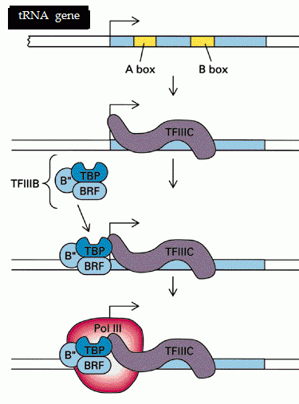

Slide 77
Class III
▪ Typical stages in a U6 snRNA (also termed class III) gene initiation (documented in vertebrates only):
▪ SNAPc (SNRNA Activating Protein complex) (also termed PBP and PTF) binds to the PSE (Proximal Sequence Element) centered approximately 55 base pairs upstream of the start site of transcription. This assembly is greatly stimulated by the Pol II transcription factors Oct1 and STAF that bind to an enhancer-like DSE (Distal Sequence Element) at least 200 base pairs upstream of the start site of transcription. These factors and promoter elements are shared between Pol II and Pol III transcription of snRNA genes.

Slide 78
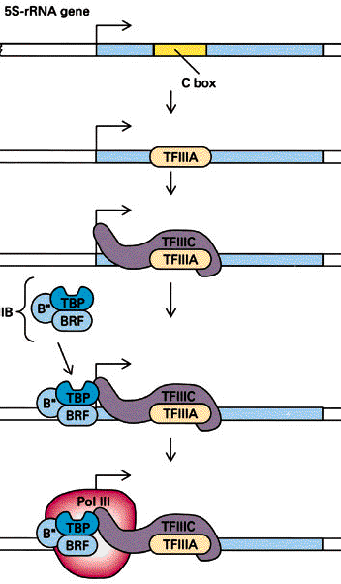

Slide 79
▪ SNAPc acts to assemble TFIIIB at a TATA box centered 26 base pairs upstream of the start site of transcription. It is the presence of a TATA box that specifies that the snRNA gene is transcribed by Pol III rather than Pol II.
▪ The TFIIIB for U6 snRNA transcription contains a smaller Brf1 paralogue, Brf2.
▪ TFIIIB is the transcription factor that assembles Pol III at the start site of transcription. Sequence conservation predicts that TFIIIB containing Brf2 also plays a role in promoter opening.
▪ Each of the internal sequence represents certain tRNA domains, such as; A block representing D-arm and B block representing TUCG loop respectively.
.

Slide 80
▪ At the time of transcriptional initiation, a transcriptional factor TF-C made up of six subunits recognizes the sequence boxes and binds to them and positions the proteins in such a way one end of the protein is found at the start site.
▪ Then this protein guides the TF-B, which is made up of several subunits, to be positioned at start site.
▪ Then the RNA pol-III recognizes these proteins and binds to them and binds tightly and initiates transcription at the pre defined site.
▪ Here the role of a promoter is to provide recognition sequence modules for specific proteins to assemble in such a way; the polymerase is properly positioned to initiate transcription exactly at a pre-defined nucleotide, which is called start site.

Slide 81
▪ If sequence motifs are not present, protein fails to bind and RNA pol fails to associate with accessory proteins and initiate transcription at specific site.
▪ In these promoters there is sequence such as TATA box for the binding of TBP, which acts as the positional factor.
▪ This is what the promoter is and what it is meant for; this is why promoter is required.
5sRNA genes:
▪ Ribosomal RNAs, in eukaryotes consist of 28s, 18s, 5.8s and 5s RNAs.
▪ The 28s, 18s and 5.8s rRNAs are synthesized as one block from nucleolar organizer region of the DNA, and the precursor 45S, larger than the final RNAs, is processed into 28s, 18s, and 5.8s RNAs, but no 5s RNA segment.

Slide 82
▪ Gene for 5s RNA are located elsewhere in the chromosomes, many times they are found just behind telomeres.
▪ The number of 5s RNA genes in a haploid genome can vary from 200 to more than 1200, and all of them are tandemly repeated in the cluster and each of them are separated by non transcribing spacer.
▪ During transcriptional initiation, TF III A first recognizes the C box and binds, then TF-III-B containing TBP binds to the promoter using TF-III A and it positions at start site.
▪ Then the RNA-pol-III complex assembles at the start region and initiates transcription at the predefined site.

Slide 83
▪ Again the role of internal promoters is to position the transcriptional factors and ultimately the RNA-pol so as to initiate at specified site.
▪ 5s RNA expression differs in Oocyte and somatic tissues.
▪ Transcription factor TF III A, 40 KD proteins is produced in Oocyte specific manner.
▪ This protein binding to internal site of the 5s gene activates the gene expression by facilitating the assembly of TF III-C and B and finally RNA pol-III.
▪ At a late stage of oogenesis, enormous quantities of 5sRNAs are produced, and the TF-III A binds to 5s RNA, thus all TF III-As get consumed and none of the factors are available for the activation of Oocyte specific 5sRNA gene.
Termination
Polymerase III terminates transcription at small polyTs stretch. In Eukaryotes, a hairpin loop is not required, as it is in prokaryotes

Slide 84
Processing
tRNA Synthesis & Processing
1. tRNA is transcribed by RNA polymerase III. The transcription product, the pre-tRNA, contains additional RNA sequences at both the 5’ and 3’-ends. These additional sequences are removed from the transcript during processing. The additional nucleotides at the 5’-end are removed by an unusual RNA containing enzyme called ribonuclease P (RNase P).
2. Some tRNA precursors contain an intron located in the anticodon arm. These introns are spliced out during processing of the tRNA.

Slide 85
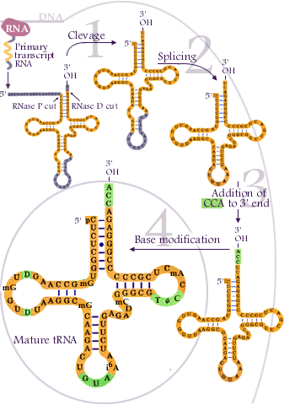

Slide 86
3. All mature tRNAs contain the trinucleotide CCA at their 3’-end. These three bases are not coded for by the tRNA gene. Instead, these nucleotides are added during processing of the pre-tRNA transcript. The enzyme responsible for the addition of the CCA-end is tRNA nucleotidyl transferase and the reaction proceeds according to the following scheme:
tRNA +CTP --> tRNA-C + PPi (pyrophosphate)
tRNA-C +CTP --> tRNA-C-C + PPi
tRNA-C-C +ATP --> tRNA-C-C-A + PPi
4. Mature tRNAs can contain up to 10% bases other than the usual adenine (A), guanine (G), cytidine (C) and uracil (U). These base modifications are introduced into the tRNA at the final processing step. The biological function of most of the modified bases is uncertain and the translation process seems normal in mutants lacking the enzymes responsible for modifying the bases.

Slide 87
INHIBITORS OF TRANSCRIPTION
α-Amanitin and actinomycin D are commonly used inhibitors of transcription. α-Amanitin binds to the largest subunits of RNA polymerase II (RNAP II) and RNAP III, with RNAP II being the most sensitive. As a consequence, the incorporation of new ribonucleotides into the nascent RNA chains is blocked
Rifamycins, macrocyclic antibiotics produced by Streptomyces mediterranei, inhibit the bacterial RNA polymerase, by binding to the beta subunit, which is one of the five subunits of the enzyme: They have little action on the human RNA polymerase. This group of antibiotics includes rifampicin, rifabutin.

Slide 88
Rifampin
Rifampin, also called rifampicin, has a bactericidal activity against a wide range of microorganisms, of which Mycobacterium tuberculosis and Mycobacterium lepræ as well as staphylococci, streptococci, Neisseria, Listeria monocytogenes, Brucella…
It is used as antituberculous drug, always combined to two or three other drugs to avoid the emergence of resistance and as anti-leprous drug. Its other clinical uses are brucellosis and the prophylaxis of meningococcal meningitis. Rifampicin (Rifadin*, Rimactan*) is marketed alone and in combination with isoniazid (Rifinah*) and with isoniazid and pyrazinamid (Rifater*).

Slide 89
Rifabutin
Rifabutin has an antibacterial activity quite similar to that of rifampin, it is active against mycobacteria such as Mycobacterium tuberculosis and Mycobacterium avium complex. It is also active against several gram-positive bacteria.
Rifabutin (Mycobutin*) is used for the curative treatment of multidrug-resistant tuberculosis and for the prophylactic treatment of Mycobacterium avium complex infection in immunocompromised patients. Rifabutin is a less potent microsomal enzyme inducer than rifampin and can be preferred in patients taking other drugs. Rifampin and rifabutin can elicit a rise in hepatic transaminases and thrombocytopenia and neutropenia. They give an orange color to the urine. Rifabutin can cause uveitis.

Slide 90
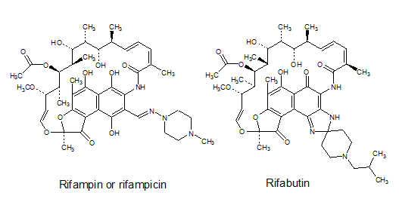
Rifamycine
Rifamycine S.V is used in the form of ophthalmic solution.
Rifapentine
Rifapentine is a rifampin analog used in certain countries for tuberculosis therapy.

Slide 91
https://tvuni.academia.edu/mvinayagam
V. Magendira Mani
Assistant Professor,
PG & Research Department of Biochemistry,
Islamiah College (Autonomous),
Vaniyambadi,
Vellore District – 6357512,
Tamilnadu, India.
magendiramani@rediffmail.com ;
vinayagam magendiramani@academia.edu

